Slide 1
Maximizing Revenue through Dynamic Pricing for Fitness Classes
Data Analysis and Recommendations
By Kaushic G

Slide 2
Introduction & Objectives
Analyze historical fitness class booking data (April-June 2018).
Identify key demand patterns and influencing factors.
Develop and evaluate a dynamic pricing strategy.
Provide data-driven business recommendations to optimize revenue.

Slide 3
Data Overview & Cleaning
Combined data from "Classes April-May 2018.csv" and "Classes June 2018.csv".
Standardized column names and handled missing data.
Cleaned class names and converted date/time formats.
Created a cleaned dataset for analysis.

Slide 4
Overall Demand Forecasting (SARIMA Model)
Aggregated daily bookings to create a time series.
Trained a SARIMA model to forecast total daily demand.
Initial SARIMA(1, 1, 1)x(1, 1, 1, 7) model showed a Mean Absolute Error (MAE) of 87.24 and Mean Squared Error (MSE) of 12238.76.
Refined SARIMA(1, 1, 0)x(0, 1, 1, 7) model improved accuracy (MAE: 69.64, MSE: 7282.22).
Future forecasts indicate continuing weekly seasonality.

Slide 5
Covariance matrix calculated using the outer product of gradients (complex-step).
Mean Absolute Error (MAE) for alternative forecasts: 69.64
Mean Squared Error (MSE) for alternative forecasts: 7282.22
Original SARIMA Model Metrics:
MAE: 87.24
MSE: 12238.76
Alternative SARIMA Model Metrics:
MAE: 69.64
MSE: 7282.22

Slide 6
High-Demand Class and Time Identification
Identified top 5 classes by average bookings: Line Dance, Aquafit Noon, Zumba Gold, Body Attack, Pilates Noon.
Peak booking times observed on weekends and specific evening hours (18:00 - 20:00).
Analysis of top classes shows demand concentrated on specific days and hours within those classes (e.g., Line Dance on Tuesdays at Hour 0).

Slide 7
High-Demand Class and Time Identification Top 5 classes by average bookings:
ClassName | Total Average Bookings
Line Dance | 40.461538
Aquafit Noon | 31.384615
Zumba Gold | 30.615385
Body Attack | 29.090909
Pilates Noon | 28.076923

Slide 8
Peak days by average bookings
Day of the Week | Total Average Bookings
Monday | 17.166976
Tuesday | 20.165766
Wednesday | 16.055300
Thursday | 16.127660
Friday | 14.352697
Saturday | 17.917293
Sunday | 19.418182

Slide 9
Correlation matrix with 'Booked' as the target variable :
MaxCapacity | 0.440306
DayOfWeek_Tuesday | 0.150892
DayOfWeek_Sunday | 0.058362
DayOfWeek_Saturday | 0.027673
DayOfWeek_Monday | 0.005721
DayOfWeek_Thursday | -0.042599
DayOfWeek_Wednesday | -0.052917
PriceINR | -0.188012

Slide 10
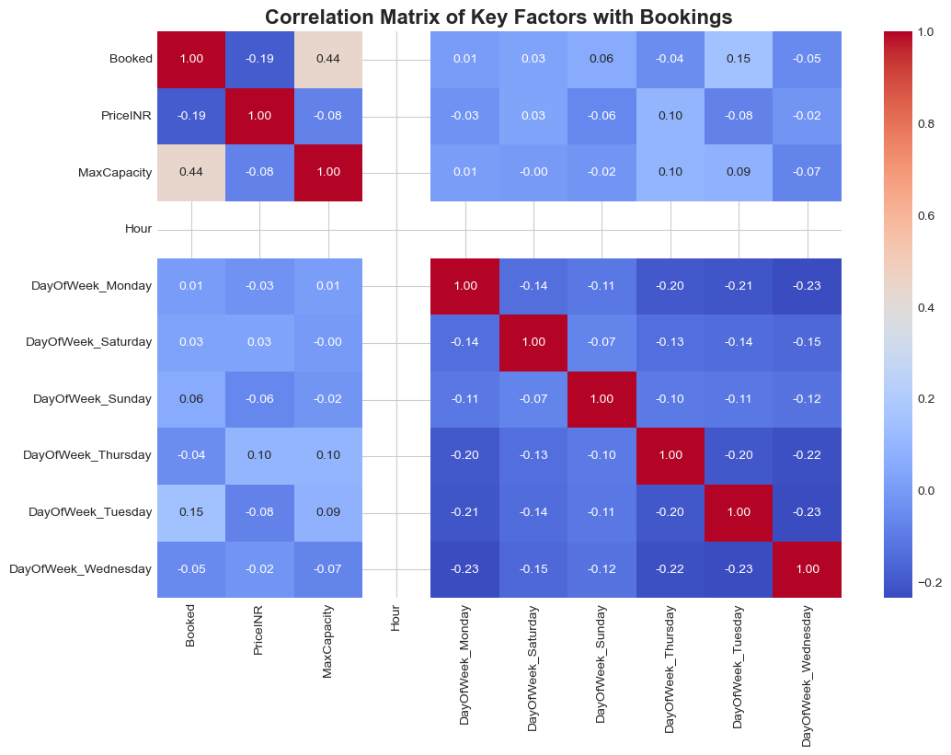

Slide 11
Key Factor Analysis
Max Capacity: Positive correlation with bookings (0.44).
Price: Negative correlation with bookings (-0.19), indicating some price sensitivity.
Day of Week: Significant impact on bookings, with Tuesdays and Sundays generally having higher averages.
Start Hour: Varies by hour, with certain hours showing higher average bookings.
Activity Site ID: Average bookings vary by location.
Duration: Could not be assessed due to lack of variance in the data.

Slide 12
Dynamic Pricing Strategy - Formulation
Based on demand peaks, price elasticity, and top-performing classes.
Leverage the relatively inelastic demand (SARIMA coefficient ~ -1.00) for strategic adjustments.
Aim to maximize revenue and optimize class utilization.

Slide 13
Proposed Dynamic Pricing Rules
Weekend Surge Pricing: Increase prices by 5-10% on Saturdays and Sundays.
Peak Hour Pricing: Increase prices by 5% during peak evening hours (18:00 - 20:00).
High-Demand Class Premium: Apply a 10% premium to the top 5 most popular classes.
Off-Peak Discounts: Introduce a 5% discount on weekdays (Monday - Thursday) during non-peak hours.

Slide 14
Dynamic Pricing Simulation & Impact
Simulated the proposed dynamic pricing algorithm.
Calculated original and simulated total revenue.
Projected Revenue Change: -0.26% (₹-256,931.49).
Original Total Revenue: ₹98,127,477.00
Simulated Total Revenue: ₹96,364,837.00
Projected Revenue Change: ₹-1,762,640.00
Projected Percentage Revenue Change: -1.80%
Note: The simulation is based on the calculated price elasticity from the overall SARIMA model. More granular elasticity for individual classes or times could yield different results.

Slide 15
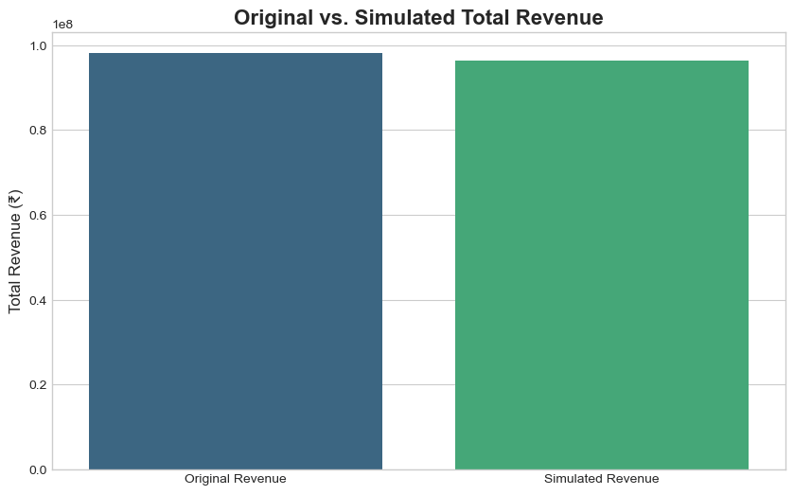

Slide 16
Business Recommendations
Implement Targeted Dynamic Pricing: Tailor pricing to specific peak days and hours for individual high-performing classes.
Utilize Refined Forecasting: Employ the improved SARIMA model for more accurate future booking predictions.
Incorporate Location and Time: Include Activity Site ID and Start Hour in dynamic pricing algorithms.
Collect More Data: Gather data on class duration and instructor to further refine analysis.
Monitor and Refine: Continuously track performance and adjust pricing strategies based on new data and feedback.

Slide 17
Conclusion
Data analysis reveals clear opportunities for revenue optimization through dynamic pricing.
A refined forecasting model provides better predictability.
Targeted strategies based on class, time, and location are key.
Continuous monitoring and data collection are essential for long-term success.

